Slide 1
Mobile Phone Application For Compressor Performance
Dustin McRae¹, Jordan Berke¹, Khristofer Thomas¹, Luis Bonilla², Trevor Hubbard²
¹Department of Mechanical Engineering
²Department of Electrical and Computer Engineering
Project Sponsor
Russell Wilburn, Industry Advisor
General Electric Oil & Gas

Slide 2
Agenda
Scope of Project
Functional Diagram
Sensor Selection
Processing and Communication
Theoretical Rationale
Mobile Application
Mounting and Housing Unit
Test Apparatus
Budget
Conclusion
Scope of Project
Scope of Project
Functional Diagram
Sensor Selection
Processing and Communication
Theoretical Rationale
Mobile Application
Mounting and Housing Unit
Constant Velocity Test Apparatus
Budget
Conclusion
Diagnostic tools are already being used by GE for compressor performance, but they…
Are too expensive
Are time consuming
Require customer to power down compressor
Create a non-intrusive flow velocity measurement system to interface with an Android mobile phone application

Slide 3
Scope of Project
Scope of Project
Functional Diagram
Sensor Selection
Processing and Communication
Theoretical Rationale
Mobile Application
Mounting and Housing Unit
Test Apparatus
Budget
Conclusion
Customer Needs
No modifications to pipes; non-intrusive method
Transfer data wirelessly to an Android phone
Software must collect, store and display data
Assembly time less than 5 minutes
Working demo

Slide 4
Functional Diagram
Scope of Project
Functional Diagram
Sensor Selection
Processing and Communication
Theoretical Rationale
Mobile Application
Mounting and Housing Unit
Budget
Conclusion
System Powered Up, Transducers Mounted, Phone Connected Wirelessly
User Inputs Parameters To Phone
Data Acquisition Unit Sends and Receives Signals
Transit Time Differences Calculated
Transit Times Sent to Phone
Phone Converts Transit Times to Velocity
Phone Graphs to P-V Diagram and Displays

Slide 5
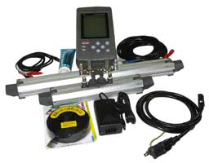
What Are Ultrasonic Transducers?
Scope of Project
Functional Diagram
Sensor Selection
Processing and Communication
Theoretical Rationale
Mobile Application
Mounting and Housing Unit
Test Apparatus
Budget
Conclusion
Generate frequencies
~18 kHz and above by
turning electrical signals
into sound via
piezoelectric crystals
Slowing of the ultrasonic signal is dictated by the properties of the medium, including its motion
This slowing can be calculated using several methods
Fulfills design spec. of unintrusive measurement

Slide 6
Transit-Time Flow Concept
Scope of Project
Functional Diagram
Sensor Selection
Processing and Communication
Theoretical Rationale
Mobile Application
Mounting and Housing Unit
Test Apparatus
Budget
Conclusion

Slide 7
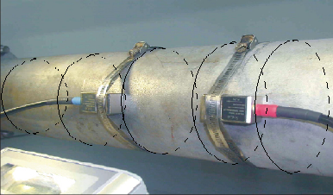
Transit-Time Flow Concept
Scope of Project
Functional Diagram
Sensor Selection
Processing and Communication
Theoretical Rationale
Mobile Application
Mounting and Housing Unit
Test Apparatus
Budget
Conclusion
Ultrasonic waves exit emitter A and are reflected off the inflection point into emitter B
Signal is slowed based on fluid properties and velocity of flow
Signal will flow faster in the direction of the flow
Clamp
Inflection Point
Trans. A
Trans. B
Trans. B
Flow Direction

Slide 8
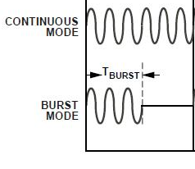
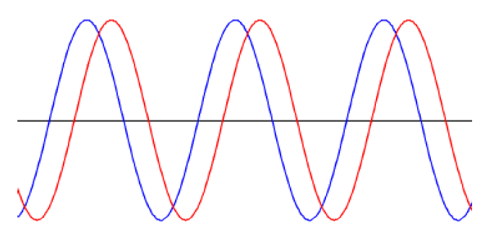
Signal Burst Method
Scope of Project
Functional Diagram
Sensor Selection
Processing and Communication
Theoretical Rationale
Mobile Application
Mounting and Housing Unit
Test Apparatus
Budget
Conclusion
Bursts of signal can be sent through
transducers with the microprocessor
waiting for input
Used on Fuji Portaflow X ultrasonic flow meter
Shannon-Nyquist Theorem
Reproduce the signal (red) and compare to
initial signal (blue)
Cross Correlation Method
Δt

Slide 9
Concepts for Data Acquisition Unit
Scope of Project
Functional Diagram
Sensor Selection
Processing and Communication
Theoretical Rationale
Mobile Application
Mounting and Housing Unit
Test Apparatus
Budget
Conclusion
Single-board PC or Microcontroller Unit?
Single-board PC contains a Field Programmable Gate Array
More time to setup operating system on Single-board PC
Wi-Fi or Bluetooth?
Wi-Fi has greater range
Added security with Wi-Fi

Slide 10
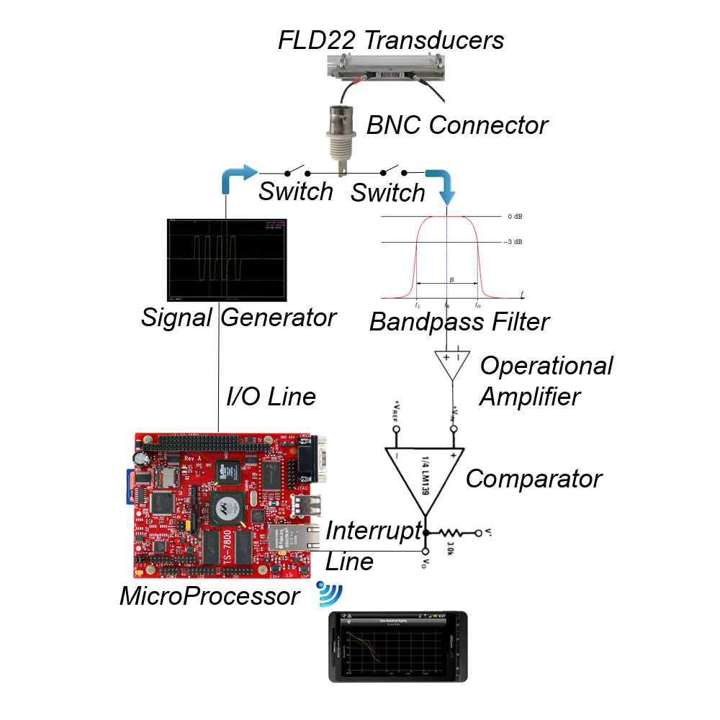
System Level Diagram
Scope of Project
Functional Diagram
Sensor Selection
Processing and Communication
Theoretical Rationale
Mobile Application
Mounting and Housing Unit
Test Apparatus
Budget
Conclusion

Slide 11
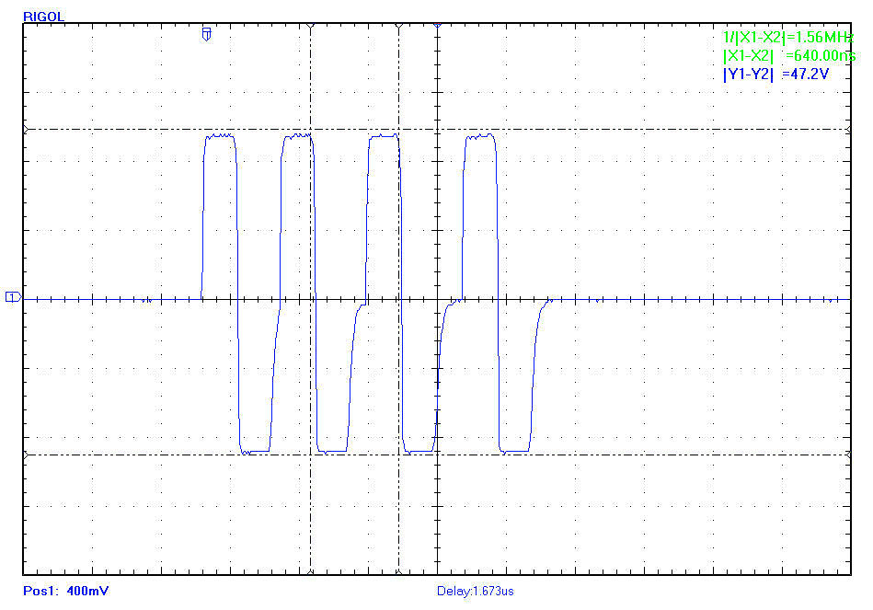
Signal Generation
Scope of Project
Functional Diagram
Sensor Selection
Processing and Communication
Theoretical Rationale
Mobile Application
Mounting and Housing Unit
Test Apparatus
Budget
Conclusion
Signal sent from Fuji Portaflow X data acquisition unit
To be reproduced on our custom unit

Slide 12
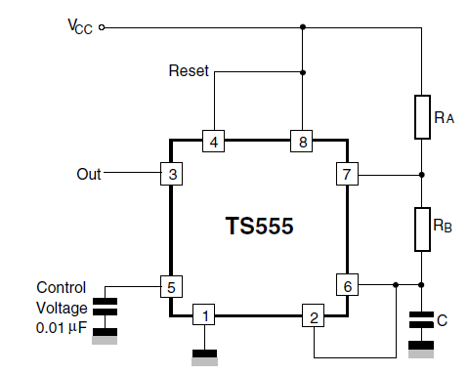
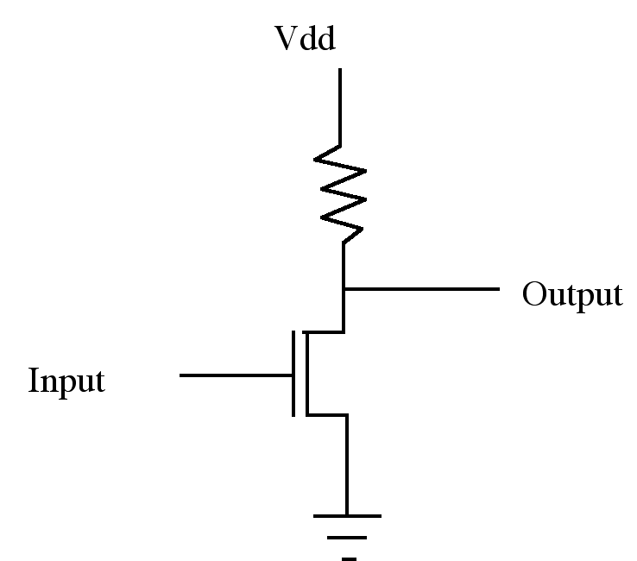
Signal Generation
Scope of Project
Functional Diagram
Sensor Selection
Processing and Communication
Theoretical Rationale
Mobile Application
Mounting and Housing Unit
Test Apparatus
Budget
Conclusion
555 Oscillator
NMOS Inverter Amplifier
TS555 generates 2 MHz square wave
Output from pin 3 is amplified to 50V by NMOS inverter amplifier

Slide 13
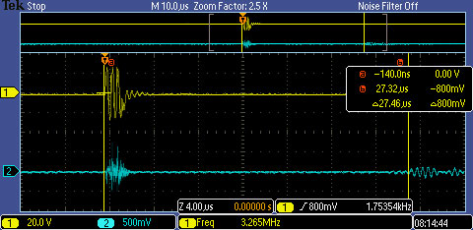
Signal Detection
Scope of Project
Functional Diagram
Sensor Selection
Processing and Communication
Theoretical Rationale
Mobile Application
Mounting and Housing Unit
Test Apparatus
Budget
Conclusion
Signal circled that needs to be detected
Band Pass Filter For 1.5Mhz-2.5Mhz

Slide 14
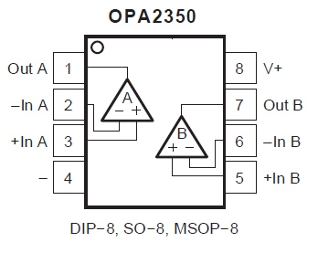
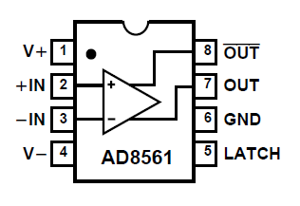
Signal Detection
Scope of Project
Functional Diagram
Sensor Selection
Processing and Communication
Theoretical Rationale
Mobile Application
Mounting and Housing Unit
Test Apparatus
Budget
Conclusion
Operational Amplifier
Comparator
7 ns Propagation Delay at 5V
Single Supply Operation: 3V to 10V
Wide Bandwidth: 38MHz
Simple non-inverting amplifier configuration used for op amp
Comparator will be used to set off interrupt on microprocessor

Slide 15
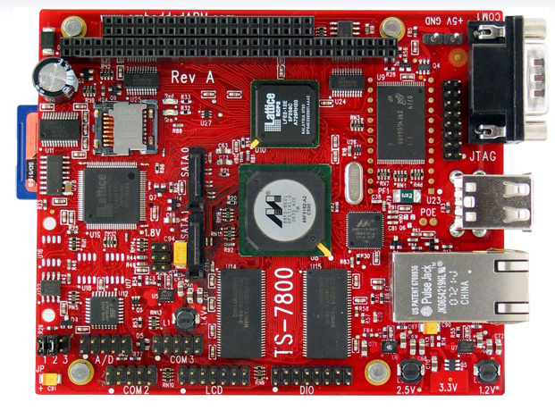
Data Acquisition Unit’s Processor
Scope of Project
Functional Diagram
Sensor Selection
Processing and Communication
Theoretical Rationale
Mobile Application
Mounting and Housing Unit
Test Apparatus
Budget
Conclusion
TS-7800 Single Board PC
500 MHz ARM9 CPU
12,000 LUT programmable FPGA
Runs Kernel 2.6 and Debian by default

Slide 16
Kernel Module
Scope of Project
Functional Diagram
Sensor Selection
Processing and Communication
Theoretical Rationale
Mobile Application
Mounting and Housing Unit
Test Apparatus
Budget
Conclusion
Set Pins for ISA and Correct Data Direction
Set IRQs
Create & Run Thread.
Disable Interrupts
Send Burst & Stamp Time
Enable Interrupts
Did Interrupt Occur?
Y
N
Stamp Time
Send to Database for Phone Transfer
Are Both Interrupts Handled?
N
Y
Calculate Transit Times

Slide 17
Communication To Phone
Scope of Project
Functional Diagram
Sensor Selection
Processing and Communication
Theoretical Rationale
Mobile Application
Mounting and Housing Unit
Test Apparatus
Budget
Conclusion
ThinkPenguin Wireless N USB Adapter
Data Transfer Rate - Up to 300Mbps
Security - WEP, WPA. WPA2, WPA-PSK/WPA2-PSK(TKIP/AES)
Required custom kernel module for 2.6.34
Driver was cross-compiled for ARM on separate Linux machine

Slide 18
Compressor Flow Characteristics
Scope of Project
Functional Diagram
Sensor Selection
Processing and Communication
Theoretical Rationale
Mobile Application
Mounting and Housing Unit
Test Apparatus
Budget
Conclusion
Need two key parameters
Volumetric flow rate
Velocity is measured
Pipe diameter is known, thus hydraulic cross-section
P-V Diagram
Needed to begin diagnosis

Slide 19
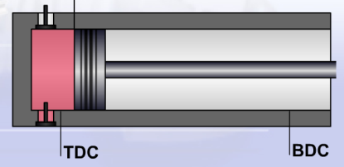
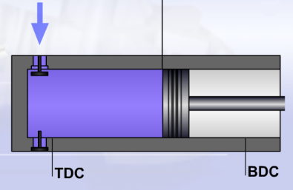
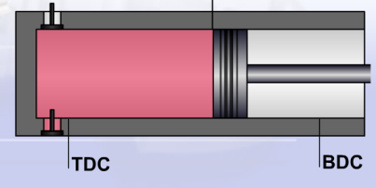
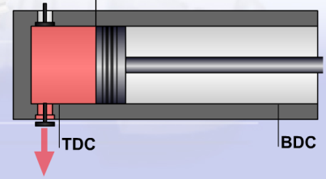
P-V Diagram
Scope of Project
Functional Diagram
Sensor Selection
Processing and Communication
Theoretical Rationale
Mobile Application
Mounting and Housing Unit
Test Apparatus
Budget
Conclusion
A-B: Re-Expansion
Pressure
D
B-C: Gas Intake
A
C
C-D: Compression
B
D-A: Gas Discharge
Volume

Slide 20
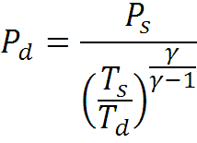
Calculating Pressure in Pipe
Scope of Project
Functional Diagram
Sensor Selection
Processing and Communication
Theoretical Rationale
Mobile Application
Mounting and Housing Unit
Test Apparatus
Budget
Conclusion
Pressure in P-V diagram is static pressure
Relationship between static pressures and temperatures in compressible fluid:
T_{s} and P_{s}: temperature and static pressure in suction pipe near suction valve, respectively
T_{d} and P_{d}: temperature and static pressure in discharge pipe near discharge valve, respectively
Need ability to measure T_{s}, T_{d} and P_{s}
Assume compressibility constant, γ = 1.4 (air)

Slide 21
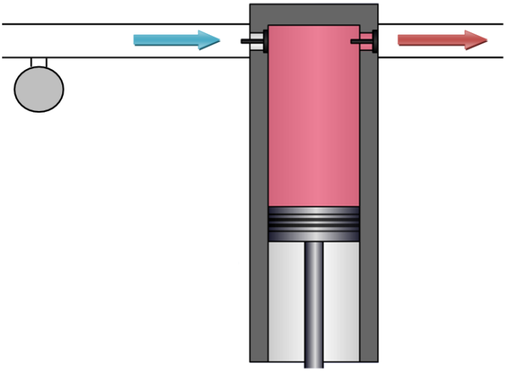
Pressure Drop in Pipe
Scope of Project
Functional Diagram
Sensor Selection
Processing and Communication
Theoretical Rationale
Mobile Application
Mounting and Housing Unit
Test Apparatus
Budget
Conclusion
Pressure drop in pipe between valve and pressure gauge:
Where:
f = Darcy friction factor
L = distance between valve and pressure gauge
D = hydraulic diameter of pipe
ρ = density of the fluid
V = measured velocity of the fluid in the pipe
Suction
Discharge
Pressure gauge

Slide 22
Pressure Drop in Pipe
Scope of Project
Functional Diagram
Sensor Selection
Processing and Communication
Theoretical Rationale
Mobile Application
Mounting and Housing Unit
Test Apparatus
Budget
Conclusion
Darcy friction factor dependent on Reynolds Number:
µ = Dynamic viscosity of the fluid
When considering laminar vs. turbulent flow, difference in pressure drop is small
- For turbulent cases that are close to laminar
So assume laminar flow:
No need for Moody charts
Preliminary diagnostic tool – no need for high precision
Much simpler for operator and App

Slide 23
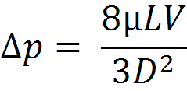
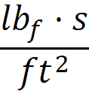
Pressure Drop in Pipe
Scope of Project
Functional Diagram
Sensor Selection
Processing and Communication
Theoretical Rationale
Mobile Application
Mounting and Housing Unit
Test Apparatus
Budget
Conclusion
Pressure drop in pipe resolves to:
Using common units:
L and D in inches, V in , µ in
Thus, suction pressure:

Slide 24
Generating P-V Curve Volumes
Scope of Project
Functional Diagram
Sensor Selection
Processing and Communication
Theoretical Rationale
Mobile Application
Mounting and Housing Unit
Test Apparatus
Budget
Conclusion
Nomenclature
B: Bore diameter
L: Stroke length
r_{c}: compression ratio
ω: rotational speed (RPM)
TDC: Top Dead Center
BDC: Bottom Dead Center
Fixed values
Live values
A
B
C
D

Slide 25
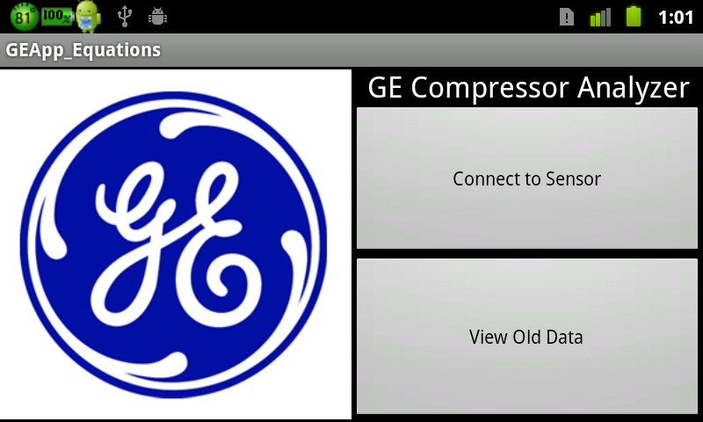
Mobile Application
Scope of Project
Functional Diagram
Sensor Selection
Processing and Communication
Theoretical Rationale
Mobile Application
Mounting and Housing Unit
Test Apparatus
Budget
Conclusion
Purpose of the app:
To collect data from Single Board PC
Store in database
Make calculations and display Flow Rate and PV graph

Slide 26
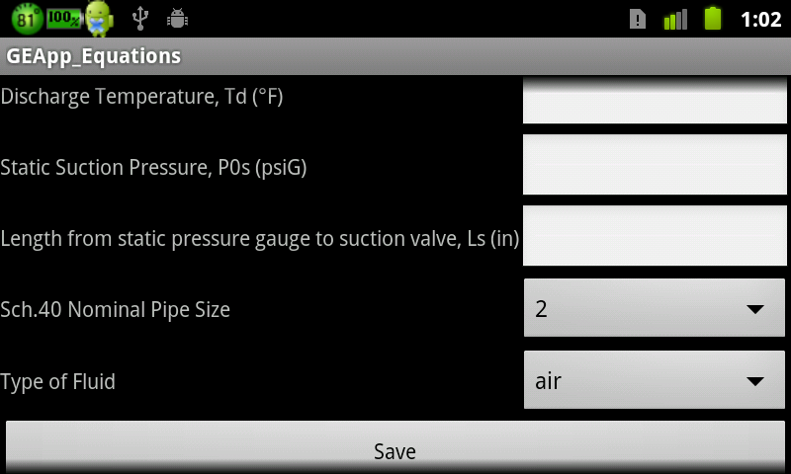
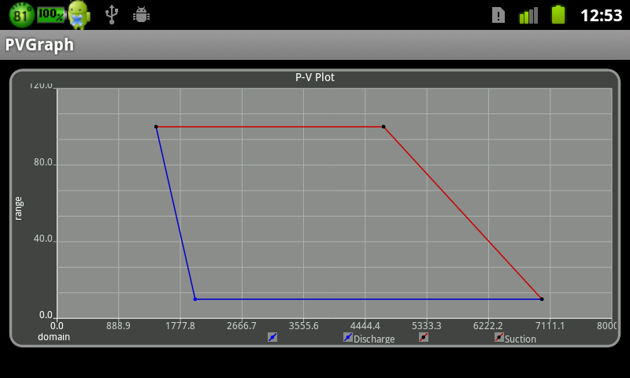
Graphical User Interface
Scope of Project
Functional Diagram
Sensor Selection
Processing and Communication
Theoretical Rationale
Mobile Application
Mounting and Housing Unit
Test Apparatus
Budget
Conclusion
App currently takes user inputs and graphs a PV plot
Inputs: T_{s}, T_{d}, P_{0s}, L_{s}, select pipe size, select fluid
Still perfecting equation implementations to make as accurate a graph as possible

Slide 27
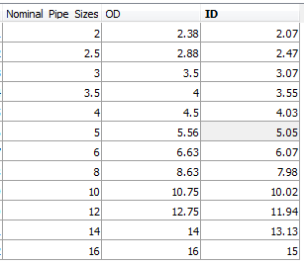
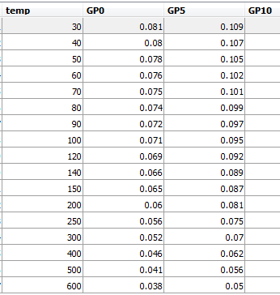
Current Implementation
Scope of Project
Functional Diagram
Sensor Selection
Processing and Communication
Theoretical Rationale
Mobile Application
Mounting and Housing Unit
Test Apparatus
Budget
Conclusion
To minimize user inputs, lookup tables were coded into the database
Schedule 40 Pipe Sizes Air Density Table

Slide 28
Future Implementation
Scope of Project
Functional Diagram
Sensor Selection
Processing and Communication
Theoretical Rationale
Mobile Application
Mounting and Housing Unit
Test Apparatus
Budget
Conclusion
Adding security measures when looking at old data
Sending data via email or web server when internet available
Adding lookup table of known compressor specs, so user inputs compressor model

Slide 29
Attaching: Mounting and Housing Unit
Scope of Project
Functional Diagram
Sensor Selection
Processing and Communication
Theoretical Rationale
Mobile Application
Mounting and Housing Unit
Test Apparatus
Budget
Conclusion
Velcro Quick Release Nylon Magnetics
Bands Hose Clamps interlocking
clamps
Spring Vise Key
Loaded Clips Attachment Attachments

Slide 30
Concept Selection for Mounting and Housing Unit
Scope of Project
Functional Diagram
Sensor Selection
Processing and Communication
Theoretical Rationale
Mobile Application
Mounting and Housing Unit
Test Apparatus
Budget
Conclusion
Pugh Matrix for Clamping System
Design Features | Current Methods | Velcro Bands | Quick Release Clamps | Interlocking Clamps | Magnetics | Importance Rating
Cost | 0 | -1 | -2 | -3 | -3 | 4.45
Lead Time | 0 | 1 | -1 | -2 | -1 | 1.73
Installation Time | 0 | -1 | 2 | -2 | 3 | 18.33
Functionality | 0 | 3 | 2 | -1 | -3 | 19.00
Usability | 0 | 1 | 1 | -1 | 2 | 17.00
Sum | 0 | 3 | 2 | -9 | -2
Total | 0 | 52.94 | 81.02 | -89.48 | 16.90
Same process done with housing unit

Slide 31
Final Concept and Results: Mounting System
Scope of Project
Functional Diagram
Sensor Selection
Processing and Communication
Theoretical Rationale
Mobile Application
Mounting and Housing Unit
Test Apparatus
Budget
Conclusion
Quick Release
Clamp
Results
Satisfies customer requirement
Needed modification
Threaded holes needed to be unthreaded
Testing used two right sided clamping attachment
Steel Plates
Quick Release
Clamp

Slide 32
Final Concept and Results: Housing Unit
Scope of Project
Functional Diagram
Sensor Selection
Processing and Communication
Theoretical Rationale
Mobile Application
Mounting and Housing Unit
Test Apparatus
Budget
Conclusion
Final Concept
Aluminum
Has a ledge for bread boards (not shown)
Fan for cooling
Vents (Not shown)
Four legs
Top
Results
Satisfies customer requirement
Needed modification
Needed longer legs

Slide 33
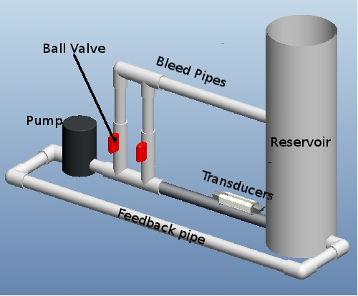
Constant Velocity Test Apparatus
Scope of Project
Functional Diagram
Sensor Selection
Processing and Communication
Theoretical Rationale
Mobile Application
Mounting and Housing Unit
Test Apparatus
Budget
Conclusion
2 Ball Valves (3 total states)
Variac (for variable voltage output) at 3 voltages
30 minutes for steady state

Slide 34
Flow Apparatus Calibration
Scope of Project
Functional Diagram
Sensor Selection
Processing and Communication
Theoretical Rationale
Mobile Application
Mounting and Housing Unit
Test Apparatus
Budget
Conclusion
Flow Situation | Both Closed | First Open | Both Open
Velocity (ft/s) | 1.4 | 1.0 | 0.7
Change in velocity due to opened ball valves
Voltage (VAC) | 60 | 90 | 120
Velocity (ft/s) | 0.8 | 0.9 | 1.4
Change in velocity due to supply voltage level (valves closed)
Flow Situation | Both Closed |  |  | First Open |  |  | Both Open
Voltage | 60 | 90 | 120 | 60 | 90 | 120 | 60 | 90 | 120
Velocity (ft/s) | 0.8 | 1.2 | 1.4 | 0.6 | 0.8 | 1.0 | 0.6 | 0.6 | 0.7
Change in velocity due to ball valves and supply voltage level

Slide 35
Budget
Scope of Project
Functional Diagram
Sensor Selection
Processing and Communication
Theoretical Rationale
Mobile Application
Mounting and Housing Unit
Test Apparatus
Budget
Conclusion

Slide 36
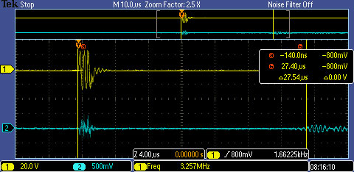
Signal Burst Proof
Scope of Project
Functional Diagram
Sensor Selection
Processing and Communication
Theoretical Rationale
Mobile Application
Mounting and Housing Unit
Test Apparatus
Budget
Conclusion
Downstream
∆27.46µs
Upstream
∆27.54µs

Slide 37
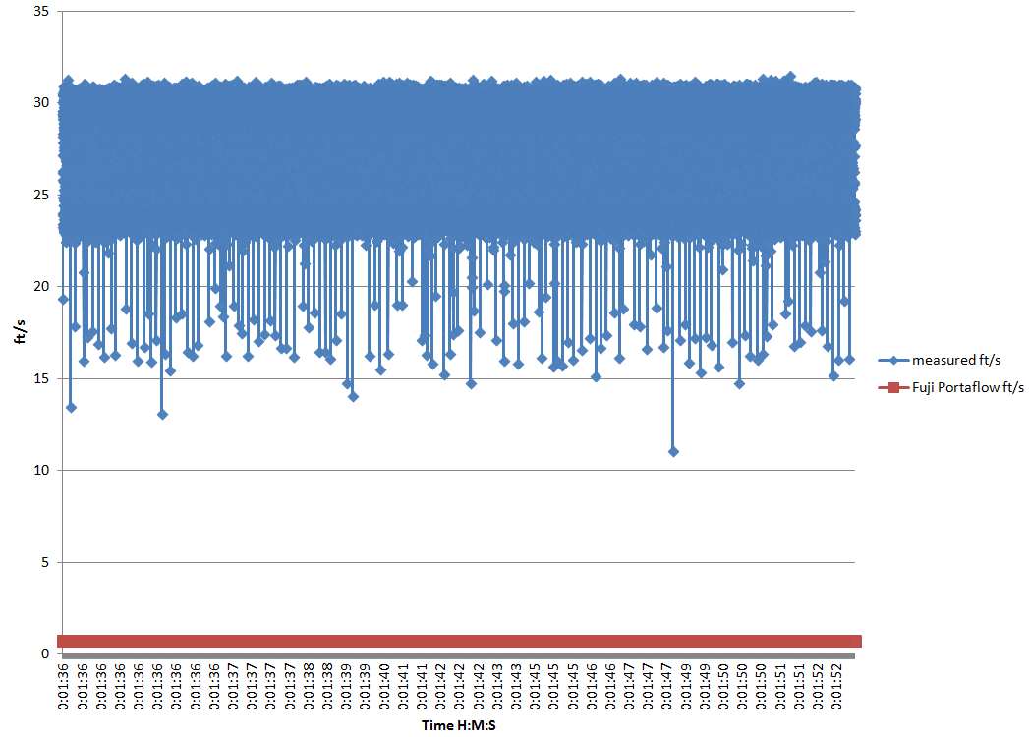
Data Acquisition Results
Scope of Project
Functional Diagram
Sensor Selection
Processing and Communication
Theoretical Rationale
Mobile Application
Mounting and Housing Unit
Test Apparatus
Budget
Conclusion
~5000 measurements per second
Measurements taken on same setup
Measured data fairly consistent but off by quite a bit, believed to be caused by spikes in the supply

Slide 38
Data Acquisition Results
Scope of Project
Functional Diagram
Sensor Selection
Processing and Communication
Theoretical Rationale
Mobile Application
Mounting and Housing Unit
Test Apparatus
Budget
Conclusion
Average t Values From Previous Graph
t up | t down | ∆t
35.48µs | 19.36µs | 16.12µs
After accounting for propagation delay through circuitry, t up appears to be a valid value when comparing to signal burst proof scope shots
35.48µs- 27.46µs=propagation delay of circuitry (to be later accounted for in calibration)
From analyzing the circuit, supply spikes may be setting off the comparator too early for t down (each up and down are on different circuitry with same components)
Solution for proof: Use ∆t value (80 ns) obtained from signal burst proof scope shots along with measured t up value to obtain velocities

Slide 39
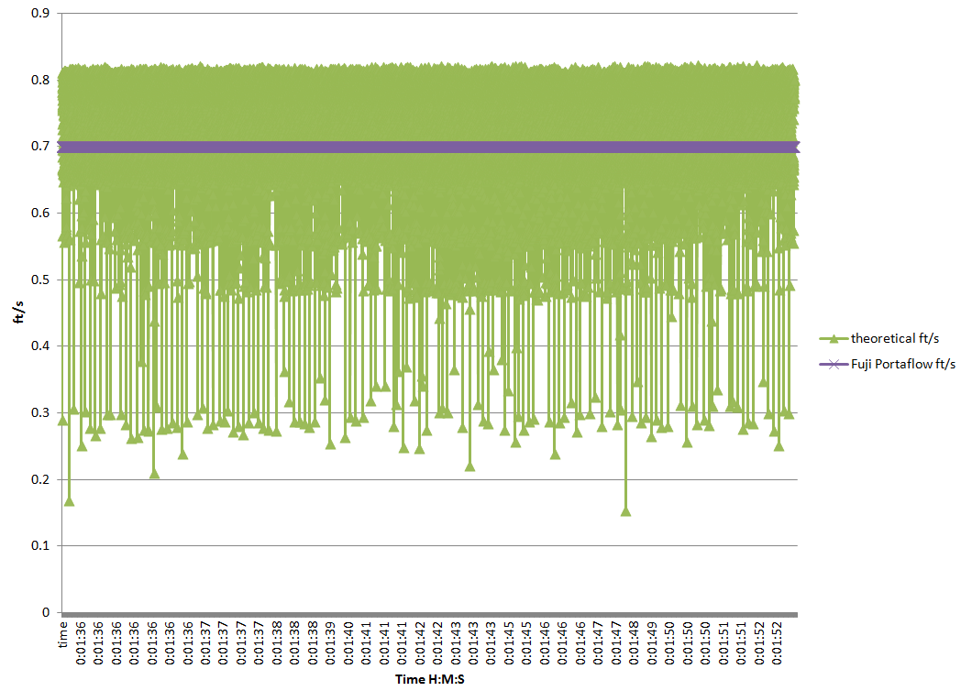
Data Acquisition Results
Scope of Project
Functional Diagram
Sensor Selection
Processing and Communication
Theoretical Rationale
Mobile Application
Mounting and Housing Unit
Test Apparatus
Budget
Conclusion
Used measured t up value along with ∆t value obtained from signal burst scope shots
Average percent error of 10.28%

Slide 40
Conclusions
Scope of Project
Functional Diagram
Sensor Selection
Processing and Communication
Theoretical Rationale
Mobile Application
Mounting and Housing Unit
Test Apparatus
Budget
Conclusion
Achievements
Future Improvements
Instruments mount in roughly 2 minutes
Signal is generated and received successfully
Measurements accurate to 2 ns with use of the 500 MHz CPU timer
~5000 measurements per second
Flow rate displayed real-time
P-V curve successfully plots live in the App
Enclosure protects electronics, cooling fan works
Housing could be made of lighter material (polymer, fiberglass, etc)
Power supply (battery) needed, currently using lab’s variable DC supply
Diagnose spikes in supply
Finalize Wi-Fi connection between SBPC and phone
Solder circuitry to euro card so that it may be secured within housing
Re-calibrate electronics to obtain less percent error in measurements

Slide 41
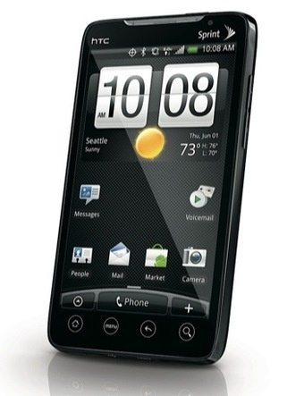
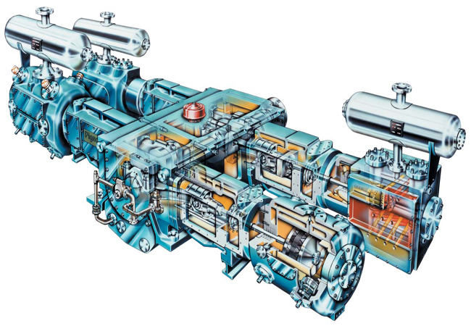
Scope of Project
Functional Diagram
Sensor Selection
Processing and Communication
Theoretical Rationale
Mobile Application
Mounting and Housing Unit
Test Apparatus
Budget
Conclusion
Questions?

Slide 42
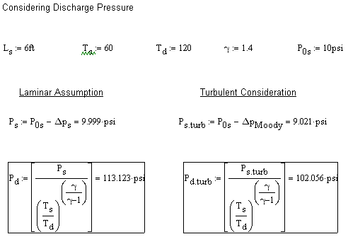
Supplementary Information
Scope of Project
Functional Diagram
Sensor Selection
Processing and Communication
Theoretical Rationale
Mobile Application
Mounting and Housing Unit
Test Apparatus
Budget
Conclusion
Conclusion:
May be useful for future design teams to explore, but not critical for initial development

Slide 43
Moody Chart
Scope of Project
Functional Diagram
Sensor Selection
Processing and Communication
Theoretical Rationale
Mobile Application
Mounting and Housing Unit
Test Apparatus
Budget
Conclusion

